Slide 1
Presence-Absence Gel Electrophoresis Results
PCR amplification was used to amplify IGF1, IGF2, and IGFBP1-5 in four male and four female samples in a series of tissues including: brain, gonad, heart, liver, muscle, tail, and regenerated tail.
Target band is indicated by the square box. Primer dimer and primer can be seen below the target band.
See last slide for verification of all failed amplifications.
Any failed amplification was redone for verification. The redos are separated by gene, and labeled with tissue and individual ID which can be matched to original amplification gel electrophoresis images. Square boxes indicate target sequences.

Slide 2
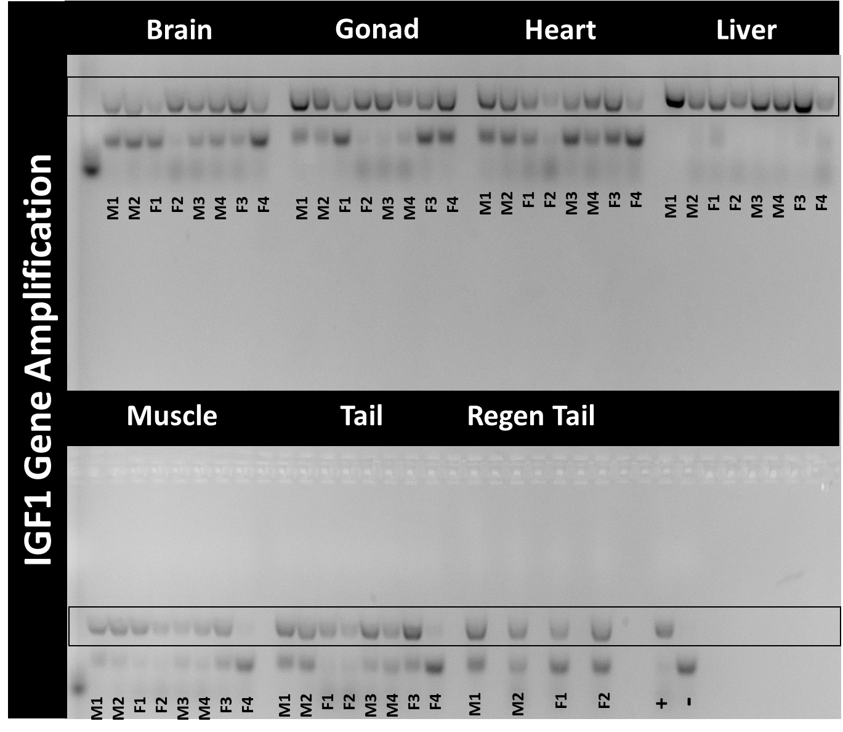

Slide 3
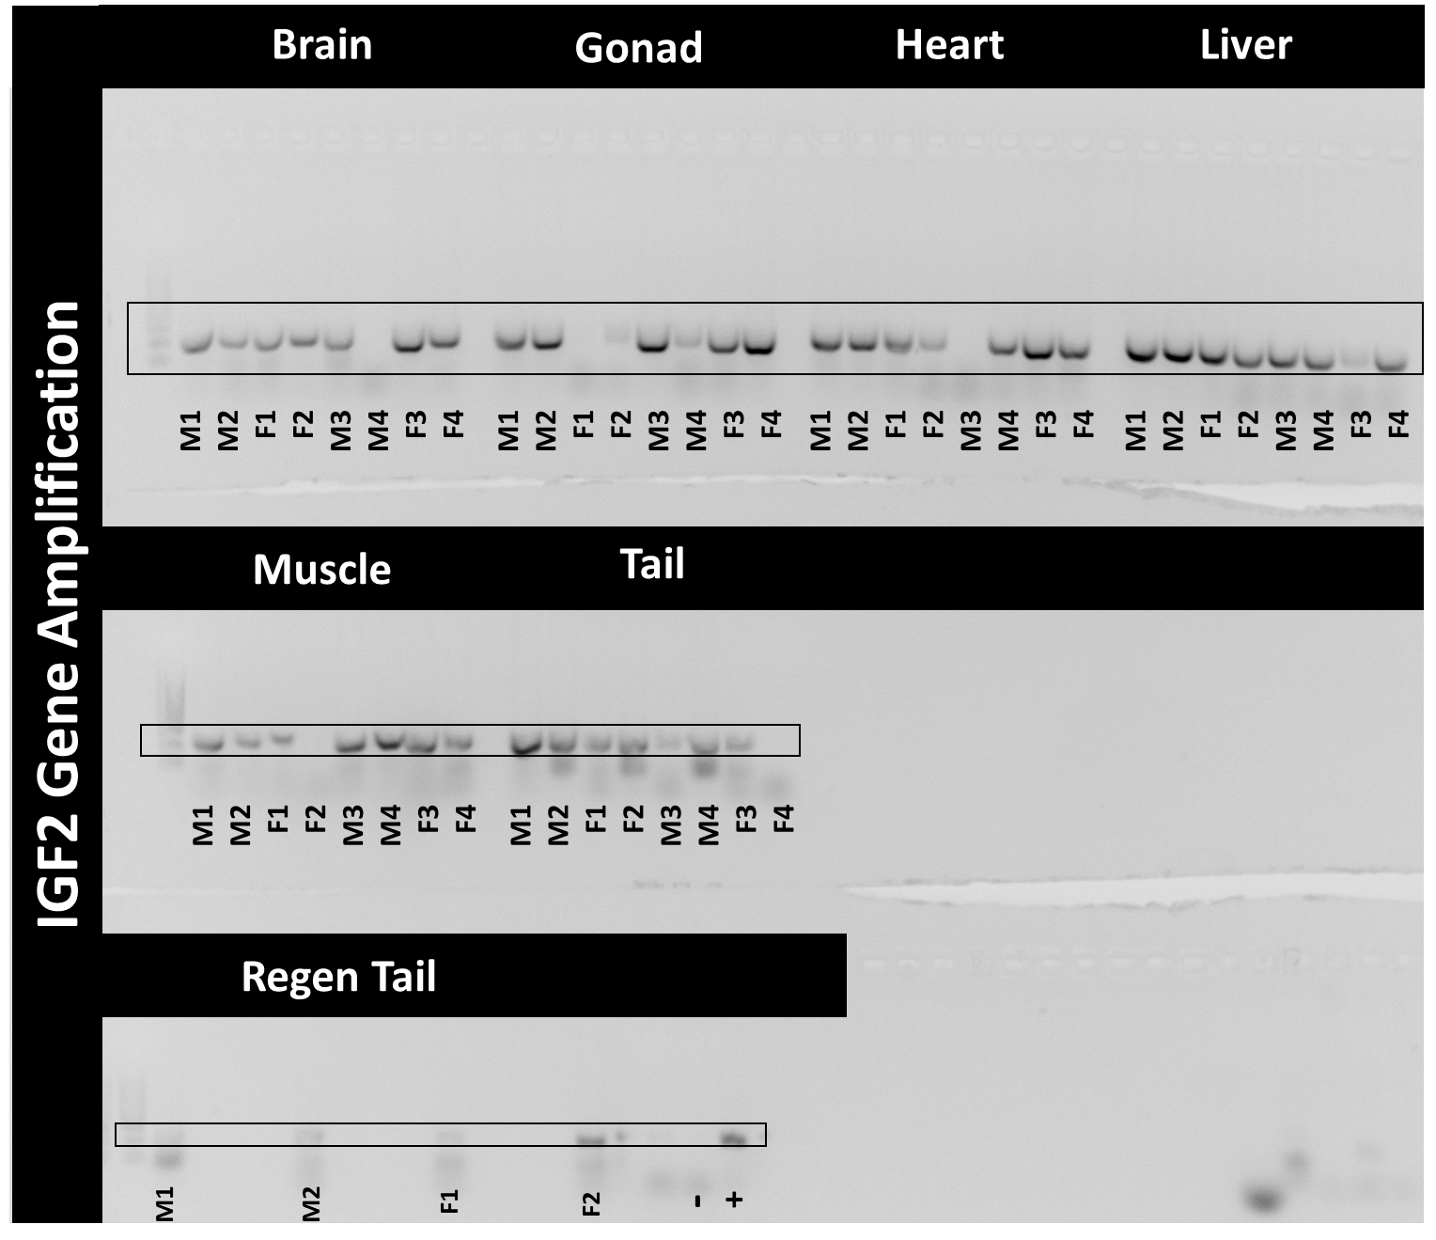

Slide 4
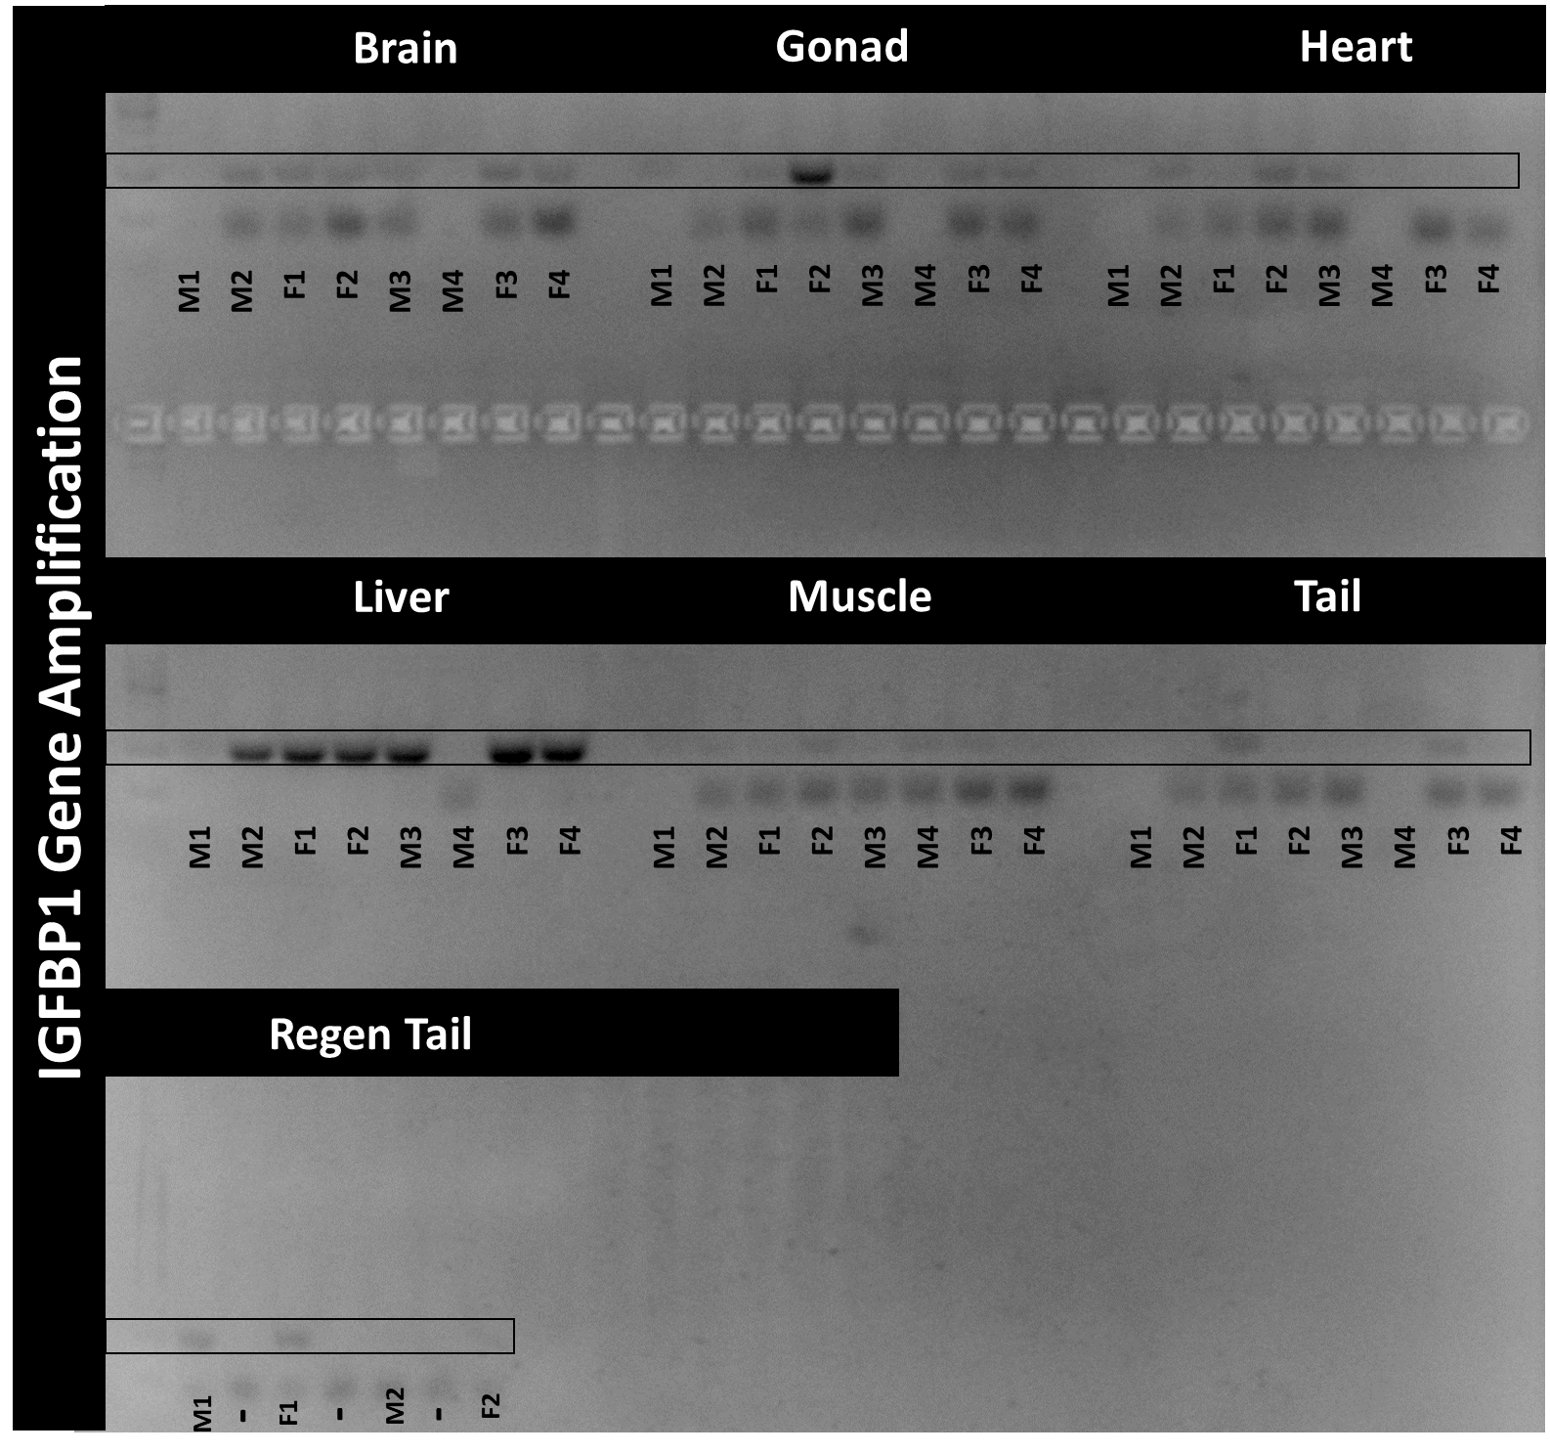

Slide 5
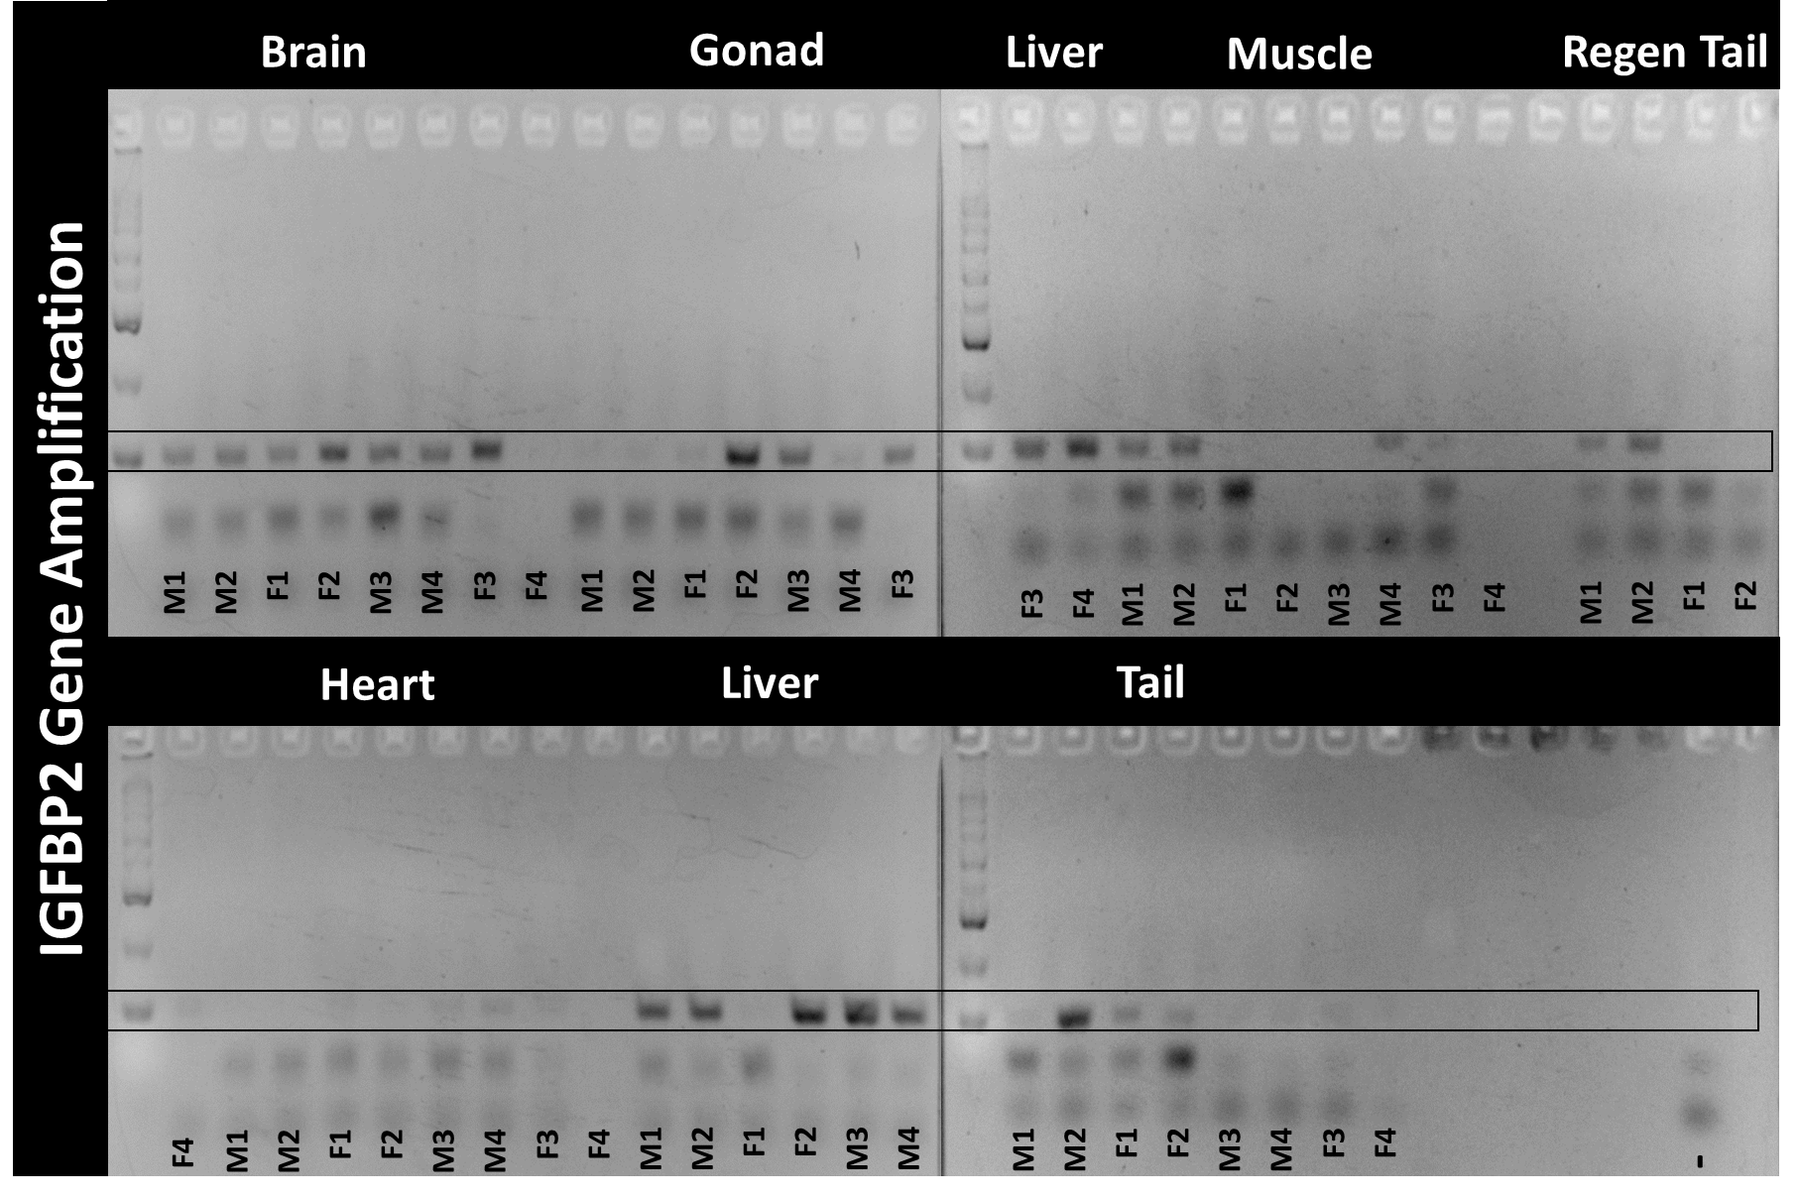

Slide 6
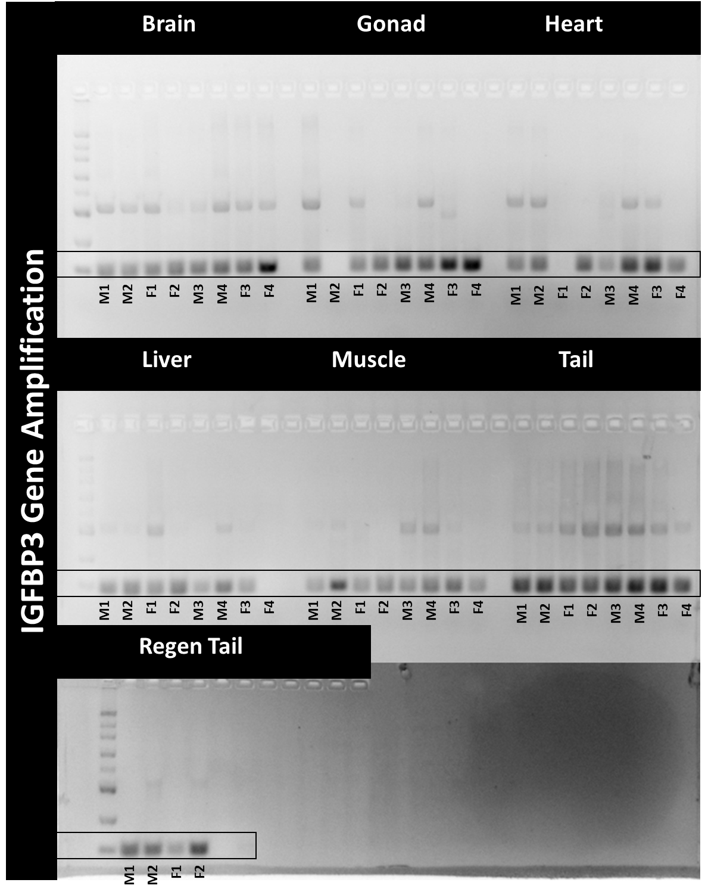

Slide 7
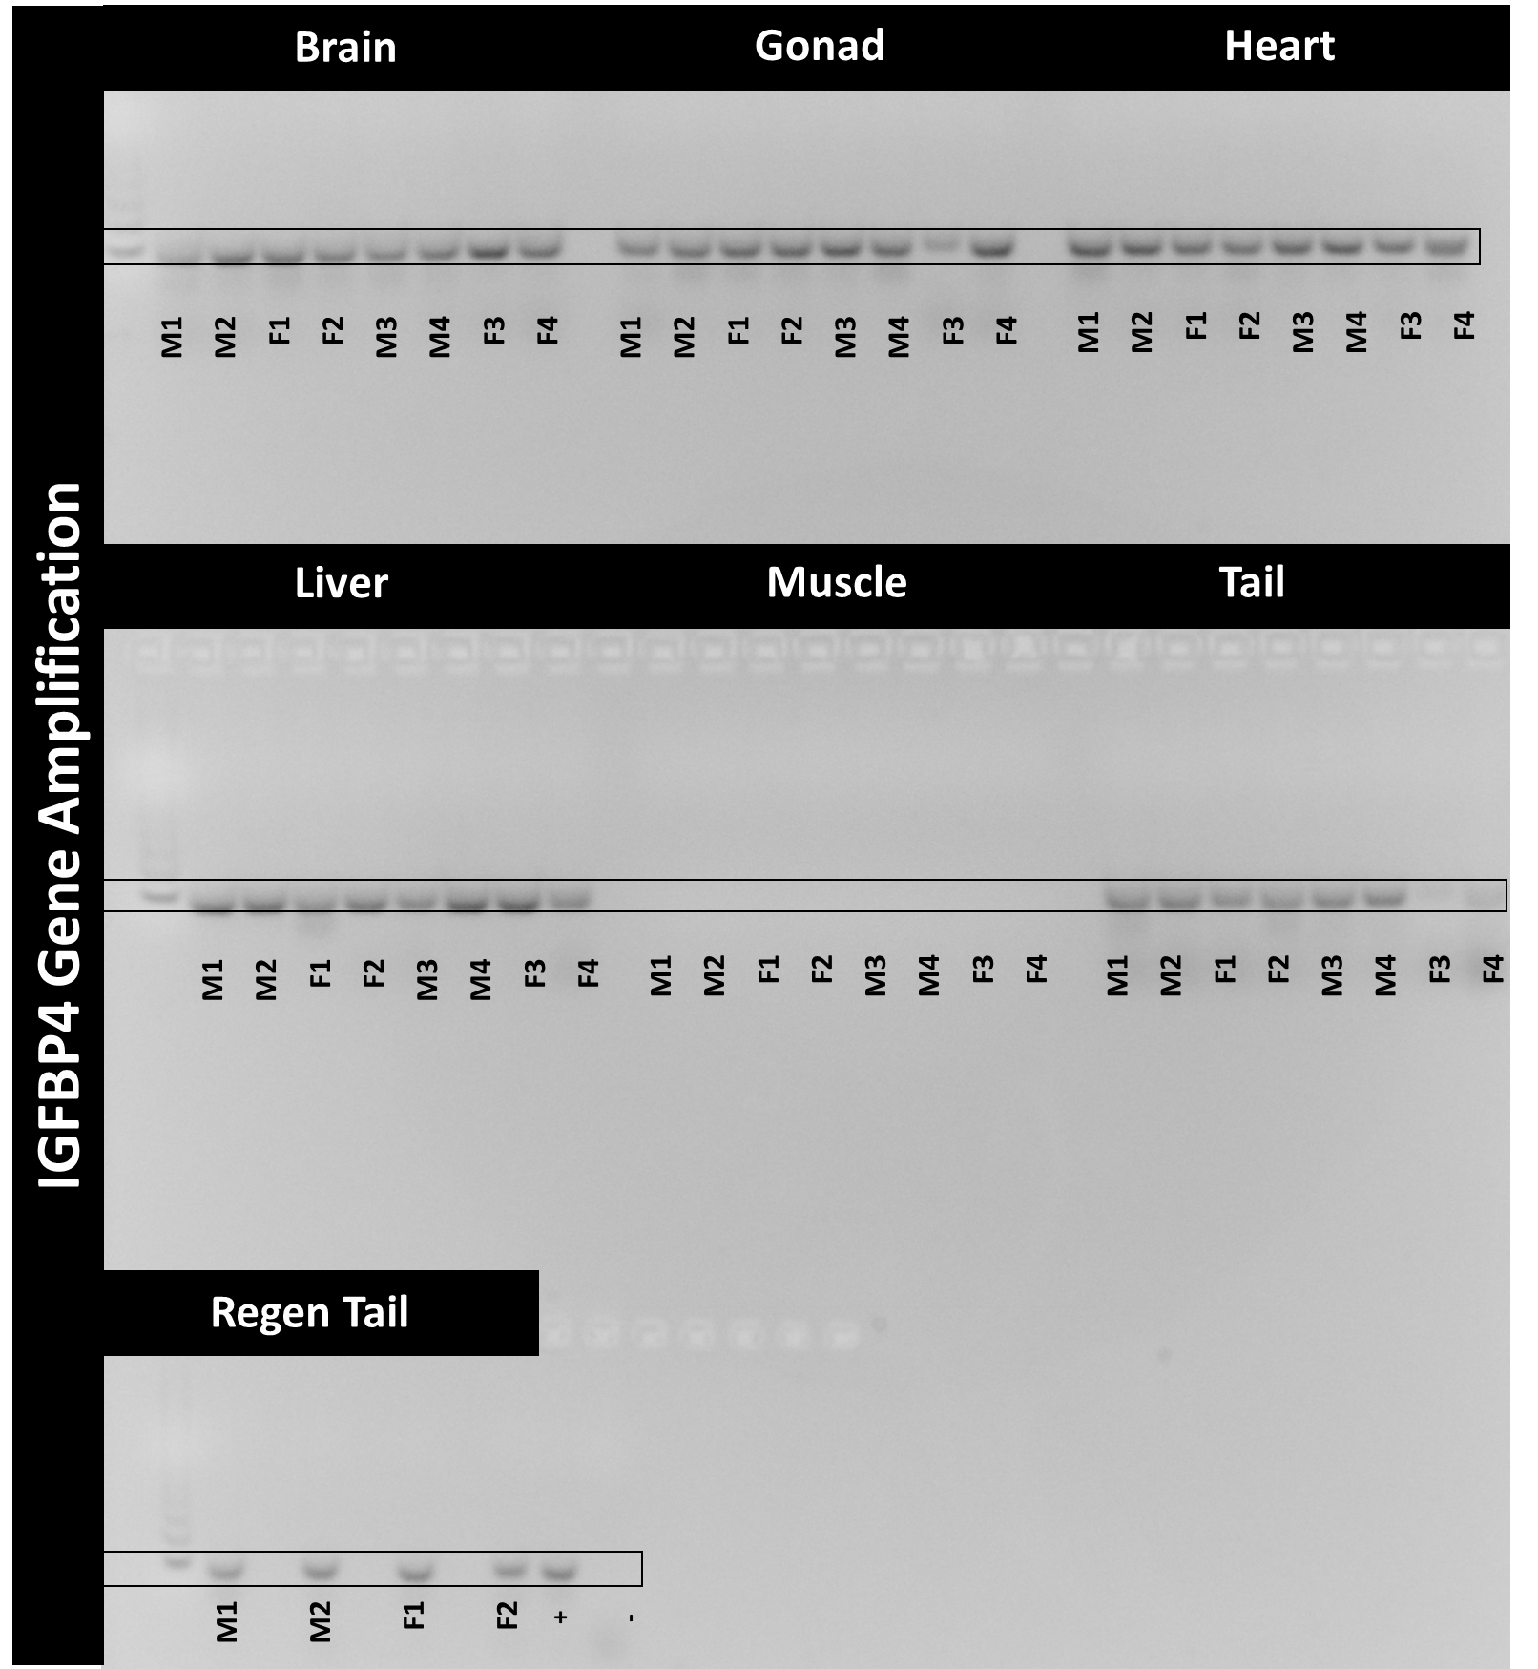

Slide 8
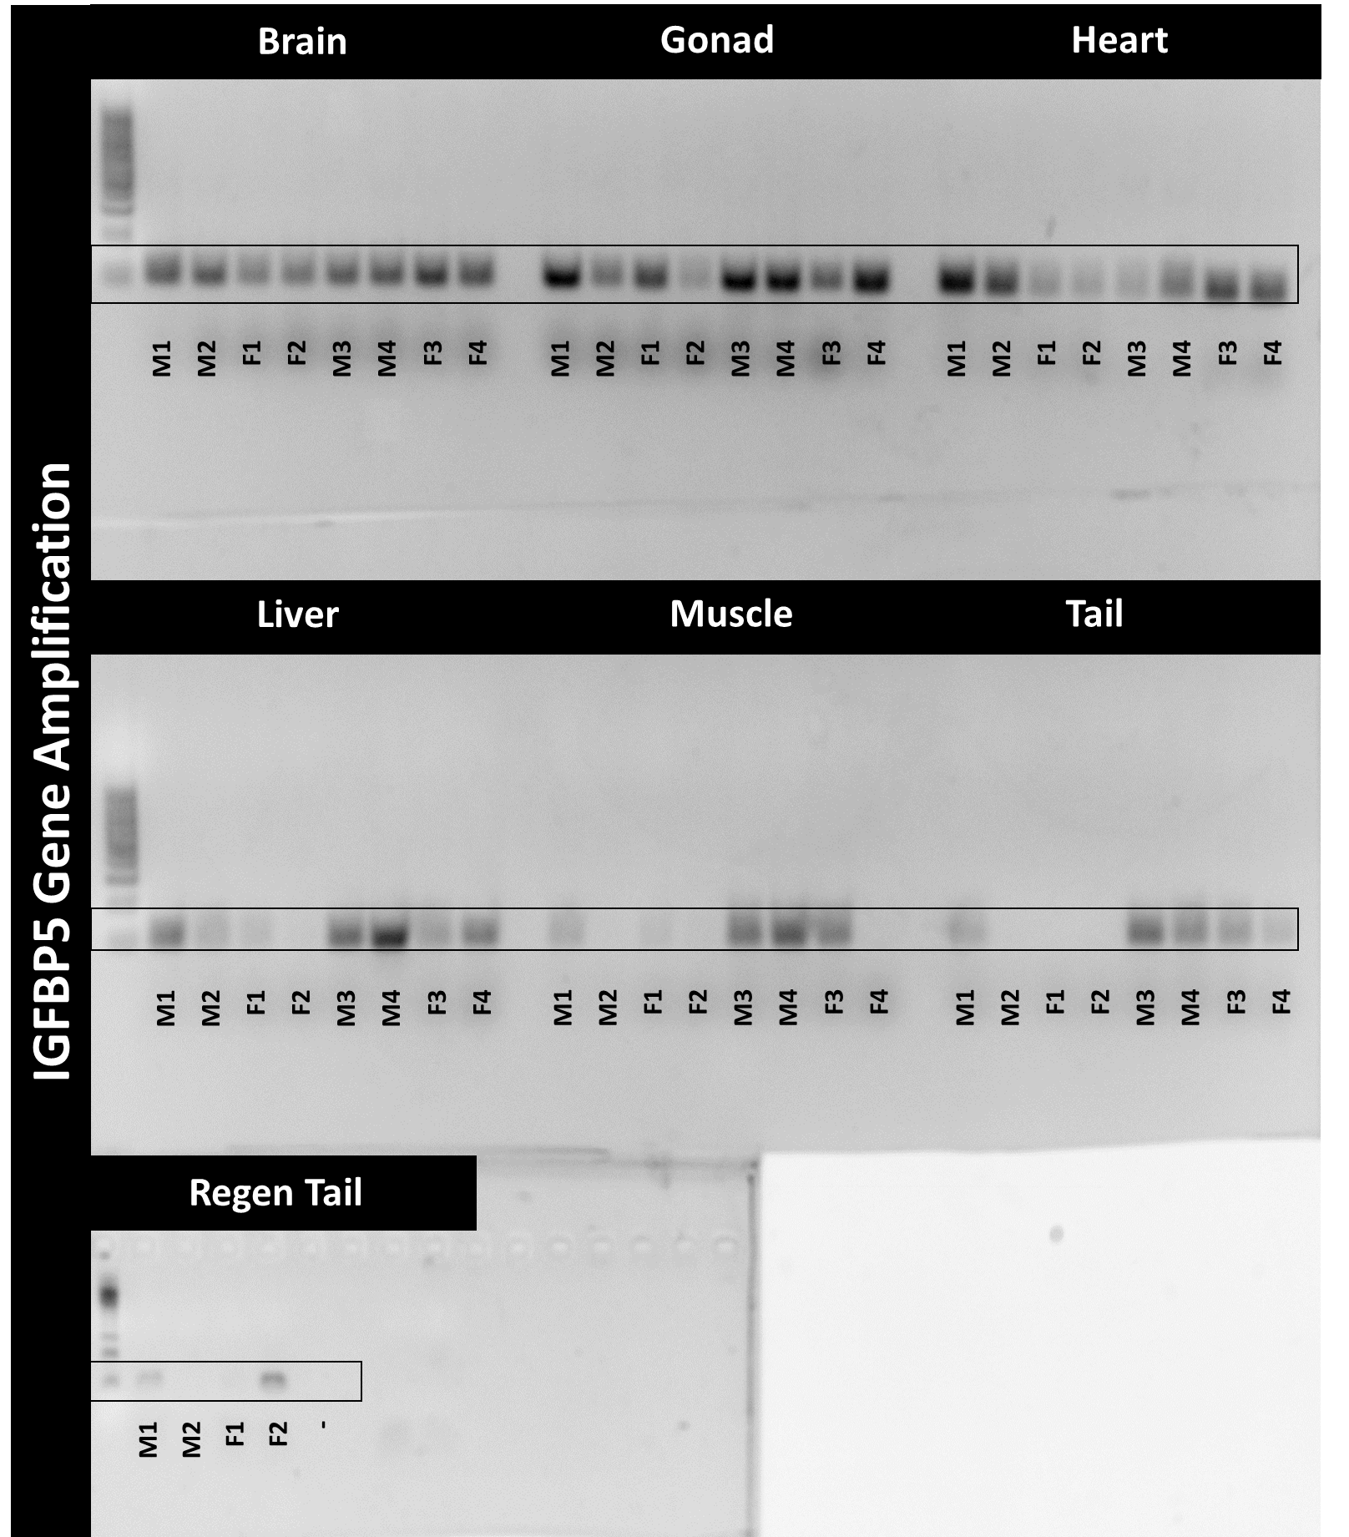

Slide 9
